Slide 1

Consistency & coherency
Ehsan Yousefzadeh-Asl
E-mail: ehsanyusefzadehasl@gmail.com
February - 2021
Notes:
NOTE:
To change the image on this slide, select the picture and delete it. Then click the Pictures icon in the placeholder to insert your own image.

Slide 2
Content
Introduction
Motivation for Memory Consistency Models and Cache Coherence
Cache Coherence Basics
Memory Model and Sequential Consistency (SC)
Total Store Order (TSO), and the X86 Memory Model
Relaxed Memory Models
Memory Consistency Models and Cache Coherence for GPUs

Slide 3
Introduction
Modern processing systems’ architects’ concern
Ensuring the correctness
Modern Computing Systems
Multi-Core Systems
Heterogeneous Systems
PIM Systems
Memory Model
Architecturally Visible Definition of Shared Memory Correctness
Order of accesses to Memory
Other names: Memory Consistency, Memory Consistency Model, Consistency
Cache Coherence
Architecturally Invisible
A part of Memory Model
Goal: Ensuring Correctness of the programmer’s program semantics
Note: Cache Coherence as a part of Memory Model

Slide 4
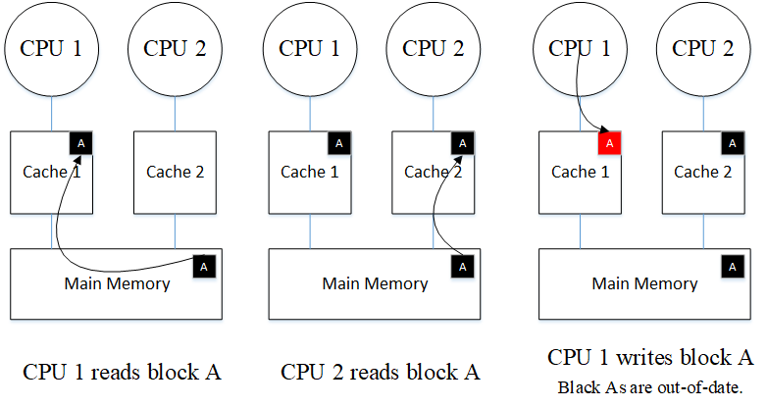
Motivation
Consider the example
Intuition: Coherence tries to make the caches of a shared-memory system invisible.

Slide 5
Cache coherence basics

Slide 6
Cache Coherence Basics (Part 1)
The actors in a Multi-Core system that lead to incoherence
Processing cores
DMA engines
External Devices with R/W accesses to caches and memory
Idea
Cache Coherence has to ensure that writes to each private data caches are made visible to all other processors
Cache Coherence Protocols
Consistency-agnostic Protocols:
Synchronous propagation of write
An illusion of atomic memory
Consistency-directed Protocols
Adhering to the memory model
Suitable for throughput-based systems: GPGPUs, Heterogeneous systems

Slide 7
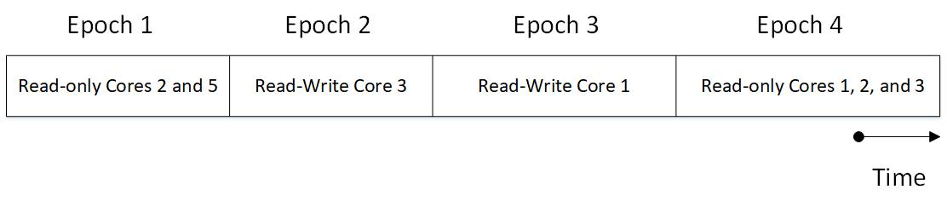
Cache Coherence Basics (Part 2)
Two invariants that must be satisfied by the cache coherence protocol
SWMR Invariant: Single Write Multiple Read to a single location of memory
Data-Value Invariant: The value of the memory location at the start of an epoch must be same as the value of the memory location at the end of the last read-write epoch.

Slide 8
Memory Consistency & SC

Slide 9
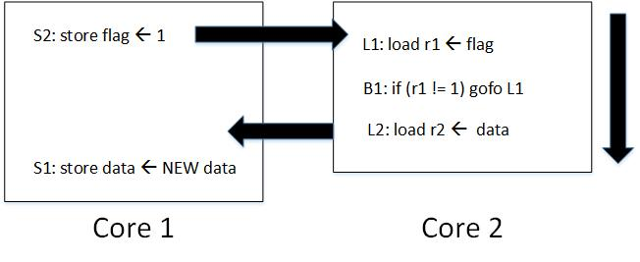
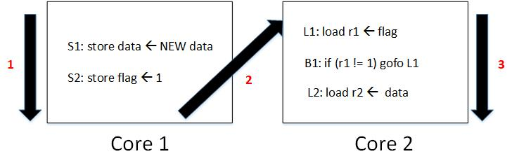
Memory Consistency (Part 1)
Memory consistency defines what programmers and implementers act based on it.
Keeping up with examples would be clearer.
Answer
No! It is caused by optimizations made in a single-core execution!
Question
Does the mentioned problem relate to cache coherence? How?
But, we know Modern Processors reorder writes! So!

Slide 10
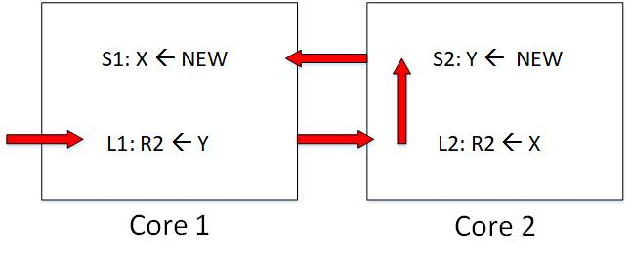
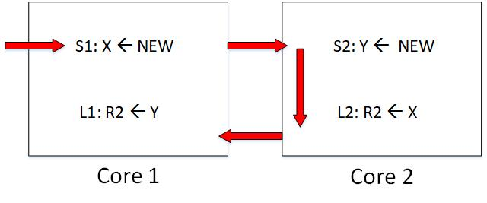
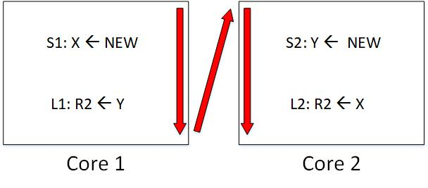
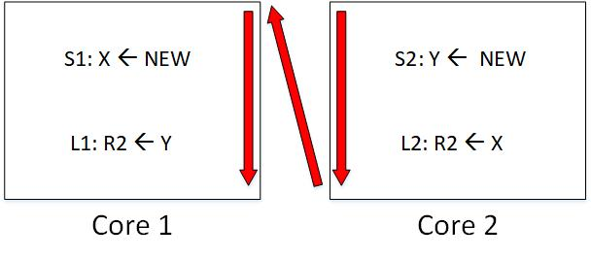
Memory Consistency (Part 2)
Different outcomes of a program running several times

Slide 11
Memory Consistency (Part 3)
Fact about Modern Processors
They are non-deterministic
Determinism is just an illusion
Sometimes created with appropriate synchronizations by software
Wrap Up
Cache Coherence != Memory Consistency
Memory Consistency Implementation can use CC as a Black Box

Slide 12
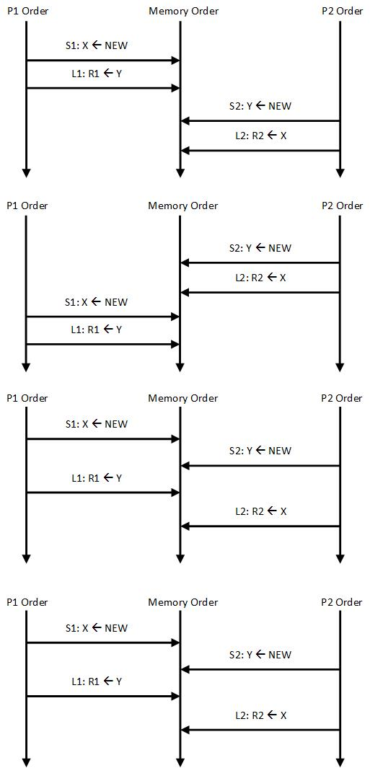
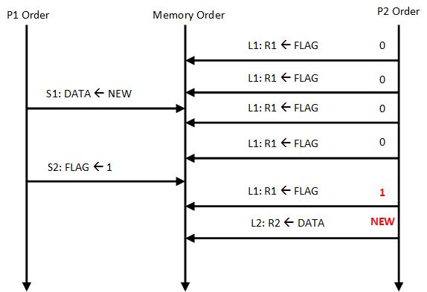
Sequential Consistency (SC)
The order of accesses to memory is same as specified in the program

Slide 13
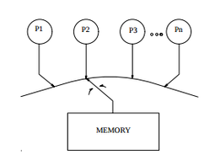
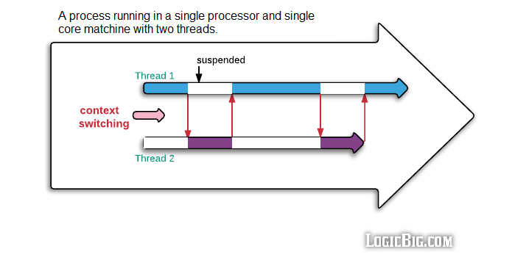
Sequential Consistency (SC) implementation
Less Naive
Very Naive

Slide 14
Total Store Order (TSO) & X86 Memory Model

Slide 15
Motivation
Modern Processor employ write buffers
For a single-core processor, a write buffer is invisible by ensuring that a load to an address return the value of the most recent store to that address from the buffer
Done by bypassing
Or by Stalling (Naive approach resulting in performance degradation)
With write buffers, hardware doesn’t respect SC
Solutions
Turning off write buffers (vendors care about performance)
SPARC and X86 solution: FIFO Write Buffers (TSO : Total Store Order)

Slide 16
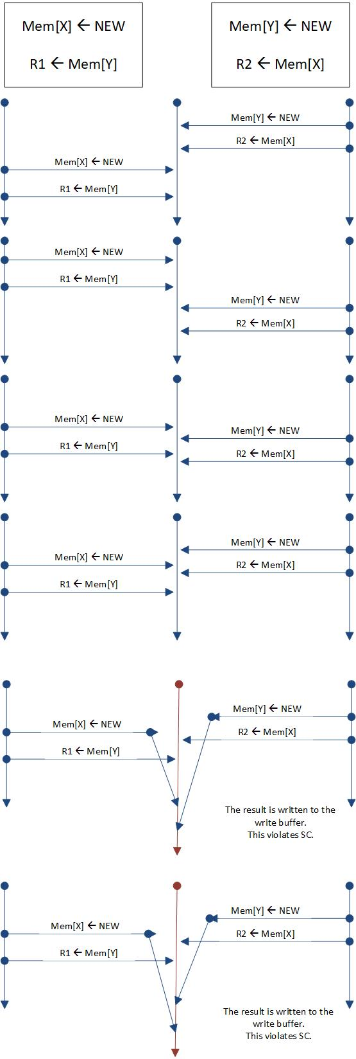
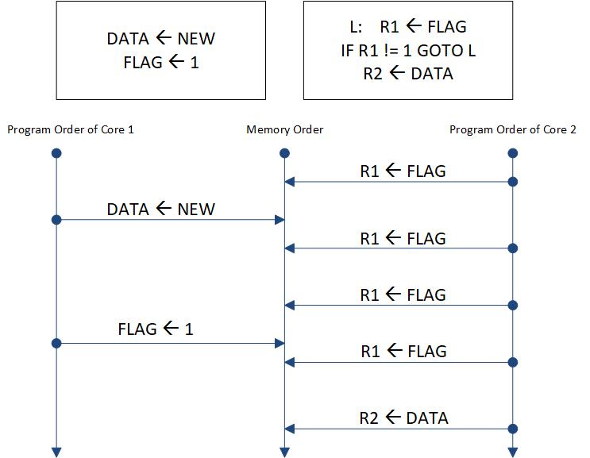
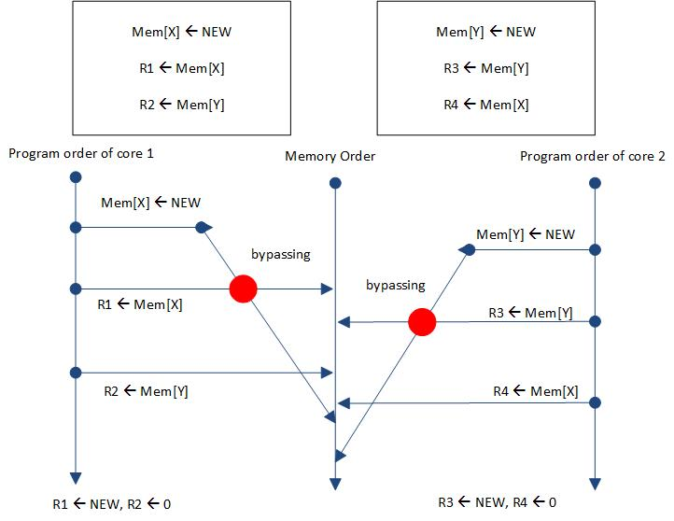
Formalization
SC requires program order preserving for each of the following orders
Load → Load
Load → Store
Store → Store (This constraint on TSO means that the write buffer should be a FIFO.)
Store → Load (when this constraint is omitted from TSO cores will be able to have write buffers.)
Programmers and compilers can prevent the execution of the TSO of the cases 5 and 6 in the above example by using FENCE instructions between stores and loads.

Slide 17
Relaxed Memory Models

Slide 18
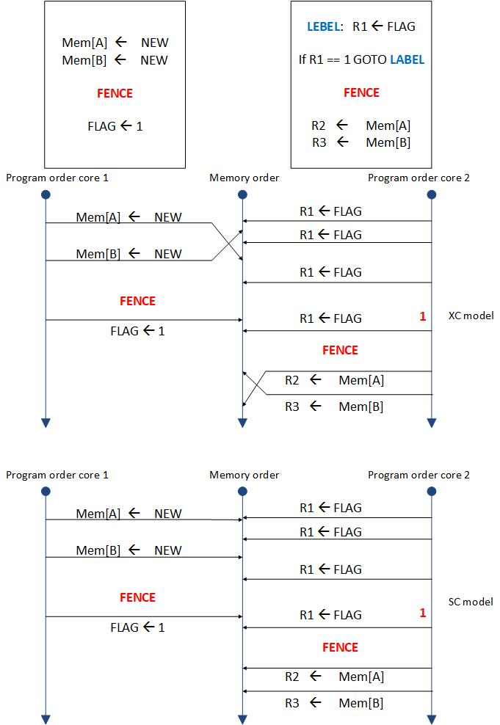
Relaxed Memory Models (XC)
No Order is preserved, only the orders specified by the programmer
Benefit: Higher Performance
Because of more hardware and software optimizations
XC: an eXample of relaxed memory Consistency model
Any Ordering is allowed inside a single-core
Unless the programmers use FENCE instructions
Write Buffers: Non-FIFO

Slide 19
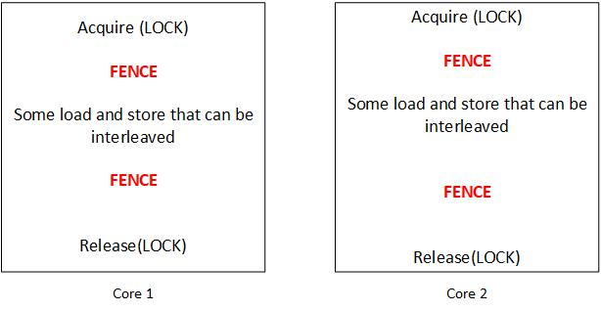
Relaxed Memory Models (RC)
In XC for synchronization operations, they were surrounded with FENCEs
However, It is not required

Slide 20
Memory Consistency Models and Cache Coherence for GPUs

Slide 21
Consistency and Coherency in GPUs (Part 1)
GPUs support relaxed memory consistency
Just preserving the order specified by the programmer
FENCE operations are CTA-scope
For synchronization and communication between two thread from two different SMs
L1 Bypassing
Downsides
Performance Inefficiency
Harder Programming Experience
No Cache Coherence Support

Slide 22
Consistency and Coherency in GPUs (Part 2)
Naive
CPU-like Protocols
Downside: Tens of thousands of active transaction! How to track all transactions?
Temporal
These methods employ inclusive L2 caches: because lease times should be kept somewhere if they going to employ non-inclusive caches, for example, they have to use MSHR for holding lease time too
Keeping Global time
Consistency-Directed
Enforcing RC
Adding O state to reduce the cost of acquires and release by tracking ownership

Slide 23
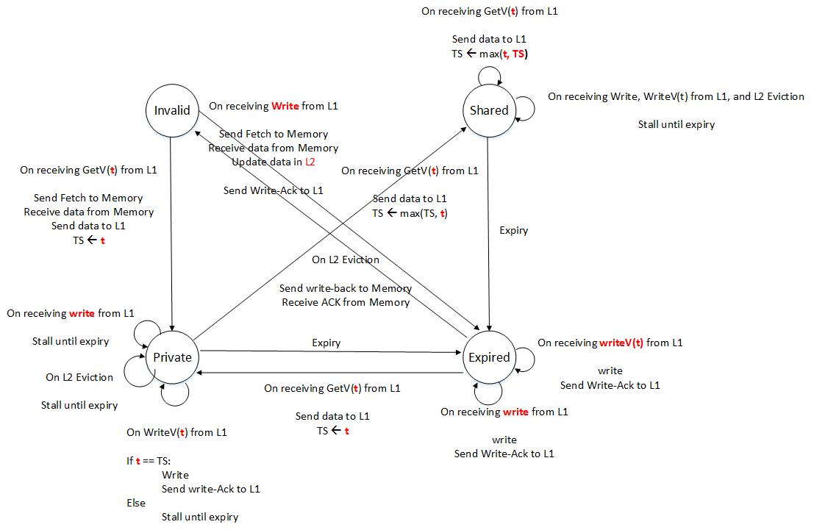
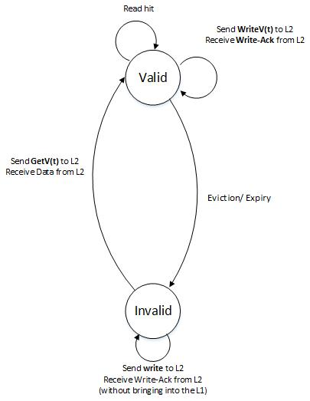
Temporal Consistency
Categorized into two groups
Consistency-agnostic
Consistency-directed
Instead of a writer validating all non-local shares, the writer waits until all of the sharers evict their block.

Slide 24

The ideas to work on this field
Reducing the cost of keeping caches coherent
Reducing Number of stall in the state-of-the-art approach
Reducing number of request, transactions
Automation of these protocols design
Making the computer architect’s life easier

Slide 25
Thanks a lot for Your Attention
Any Question? Idea? Comment?

